Slide 1
Battle of Neighborhoods Buy/Rent House in Toronto
- Steffi Mathews

Slide 2
Background
Toronto is the provincial capital of Ontario and the most populous city in Canada, with a population of 2,731,571 in 2016. Current to 2016, the Toronto census metropolitan area (CMA), of which the majority is within the Greater Toronto Area (GTA), held a population of 5,928,040, making it Canada's most populous CMA. The city is the anchor of the Golden Horseshoe, an urban agglomeration of 9,245,438 people (as of 2016) surrounding the western end of Lake Ontario. Toronto is an international centre of business, finance, arts, and culture, and is recognized as one of the most multicultural and cosmopolitan cities in the world.
People have travelled through and inhabited the Toronto area, situated on a broad sloping plateau interspersed with rivers, deep ravines, and urban forest, for more than 10,000 years. The diverse population of Toronto reflects its current and historical role as an important destination for immigrants to Canada. As an immigrant, people would like to gather a lot of information about one or more preferred locations before deciding to rent/buy a house in a new location.

Slide 3
Business Problem
This project focus to help people select the best locality to move in based on features for a neighbourhood. This includes a comparison between neighbourhoods thus saving a lot of time and money for the prospect. As a sample, this project will compare 2 neighbourhoods of Toronto and analyse the similarities and dissimilarities between the two chosen neighbourhoods to conclude with ease which neighbourhood is the best.
Factors that influence the decision to buy/rent a house in a neighbourhood of Toronto include :
Population of Neighbourhood
Average house price
Average school rating
Crime rates
Top most common places in neighbourhood

Slide 4
Data acquisition and cleaning - Data sources
https://www.toronto.ca/city-government/data-research-maps/neighbourhoods-communities/neighbourhood-profiles/ for providing an overview of the neighbourhoods in Toronto
https://www.toronto.ca/ext/open_data/catalog/data_set_files/2016_neighbourhood_profiles.csv The Census of Population is held across Canada every five years (the last being in 2016), and collects data about age and sex, families and households, language, immigration and internal migration, ethnocultural diversity, Aboriginal peoples, housing, education, income, and labour.
Foursquare API to collect information on most common venues of Borough of Toronto
Wikipedia page, https://en.wikipedia.org/wiki/List_of_postal_codes_of_Canada:_M for Toronto Neighbourhood Borough Designation
http://cocl.us/Geospatial_data that has the geographical coordinates of each postal code

Slide 5
Data acquisition and cleaning - Data Cleaning & Feature Selection
csv file http://cocl.us/Geospatial_data that has the geographical coordinates of each postal code was converted to dataset. 'Postal Code’, 'Latitude’, 'Longitude' fields were filtered from the dataset
Wikipedia page, https://en.wikipedia.org/wiki/List_of_postal_codes_of_Canada:_M was scraped in order to obtain the data that is in the table of postal codes and to transform the data into a pandas dataset. 'Postal Code’, 'Borough’, 'Neighbourhood' were filtered.
Both the dataset were merged using postal code to find the geo cordinates for neighbourhood
Data is filtered to remove Borough other than Toronto

Slide 6
Methodology
Business Understanding
Our main goal is to get an ideal location in Toronto to buy/rent a house.
Analytic Approach
Segmenting and Clustering of the neighbourhood of Toronto is done for exploratory data analysis.

Slide 7
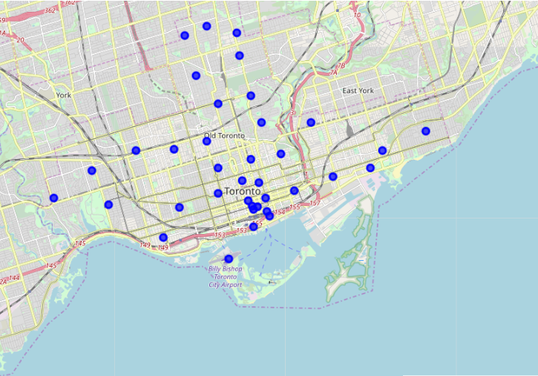
Exploratory Data Analysis - Neighbourhood of Toronto

Slide 8
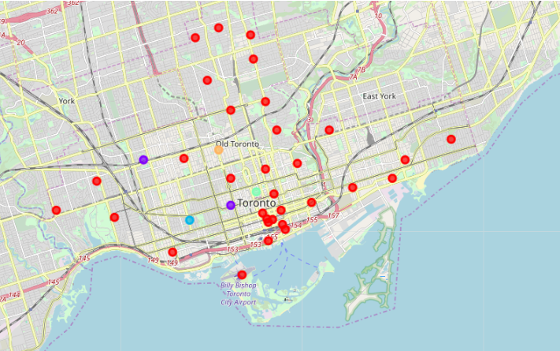
Exploratory Data Analysis - Clustering

Slide 9
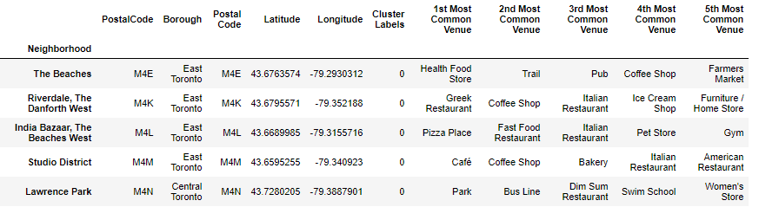
Neighbourhood of Toronto - 5 most common venue

Slide 10
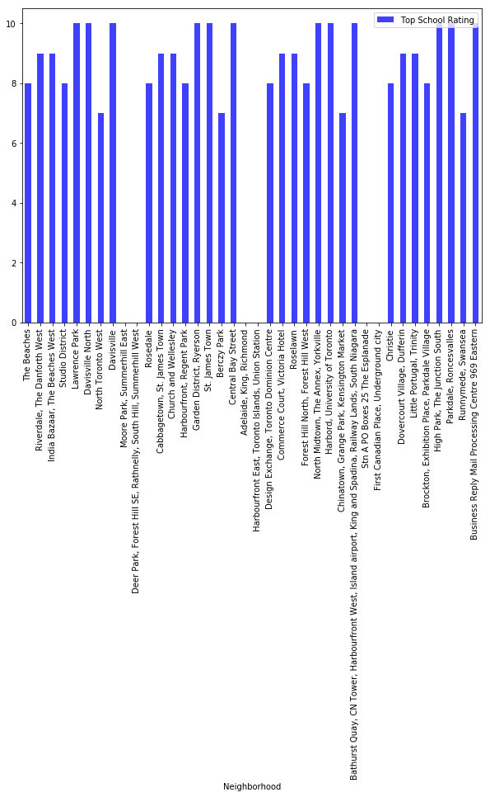
Neighbourhood of Toronto - Average school ratings

Slide 11
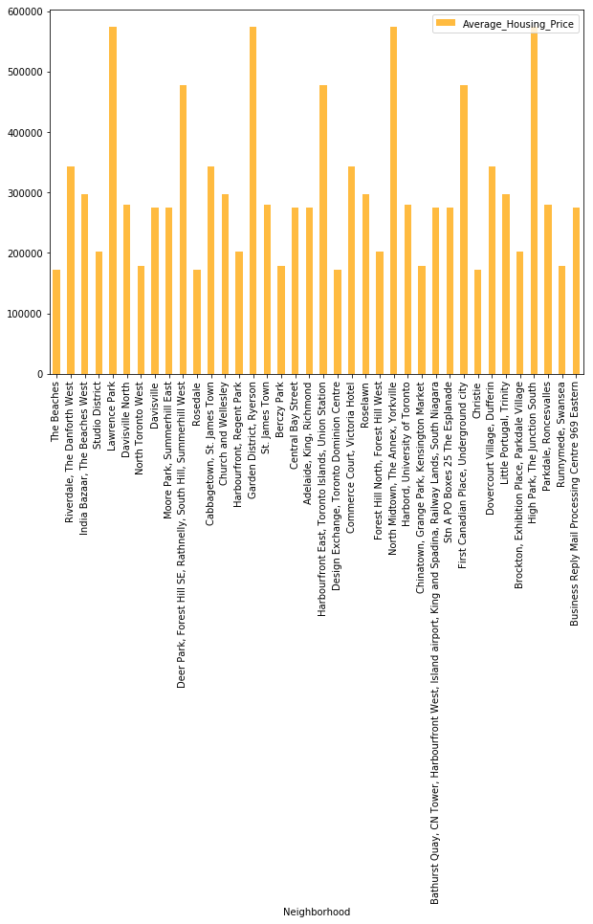
Neighbourhood of Toronto - Average house price

Slide 12
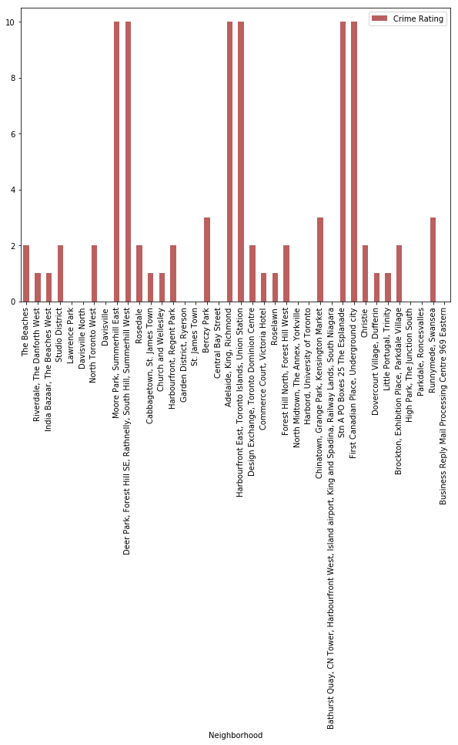
Neighbourhood of Toronto – Crime Rate

Slide 13
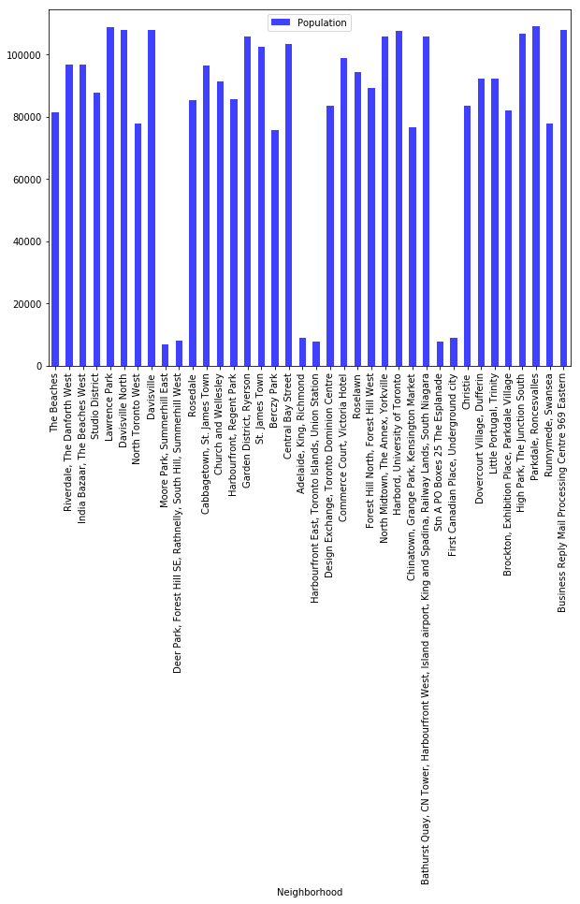
Neighbourhood of Toronto – Population

Slide 14
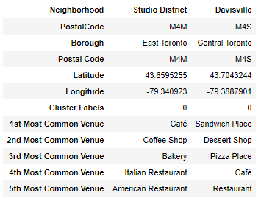
Studio District vs Davisville - Top 5 common place

Slide 15
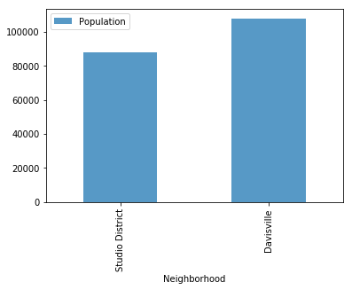
Studio District vs Davisville - Population

Slide 16
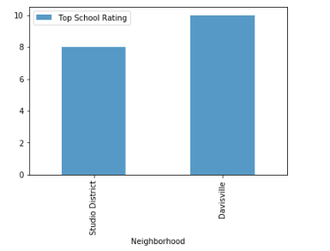
Studio District vs Davisville – School Rating

Slide 17
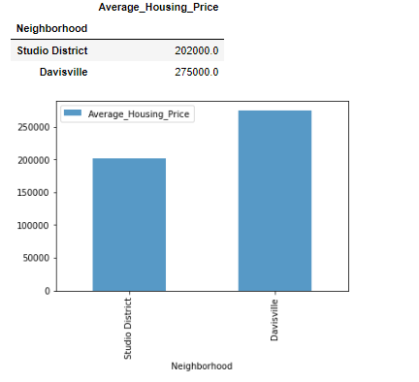
Studio District vs Davisville – Average House Price

Slide 18
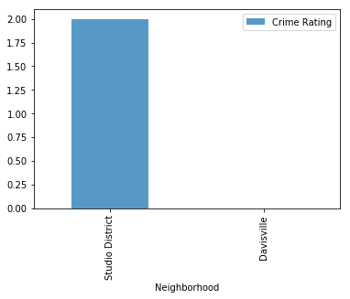
Studio District vs Davisville – Crime Rate

Slide 19
Discussion
Compared to Studio District, Davisville has the higher number of population ,good school rating , less crime rate and a reasonable avg housing price ,also top 5 common venues shows Davisville has gotton a good neighborhood. In future the analysis can be generalized to
both residential and commercial space
add more factors like job/study location
and a neighbourhood prediction engine can be modelled using clustering and segmentation for reliable prediction results.

Slide 20
Conclusion
This Analysis concludes Davisville is a better locality to buy/rent a house based of factors like population, school rating, crime rate , top common venues and average house price.

Slide 21
Thank you

